Slide 1
Immunological diseases
Dr. Husham Aldaoseri
11-Oct. 2023

Slide 2
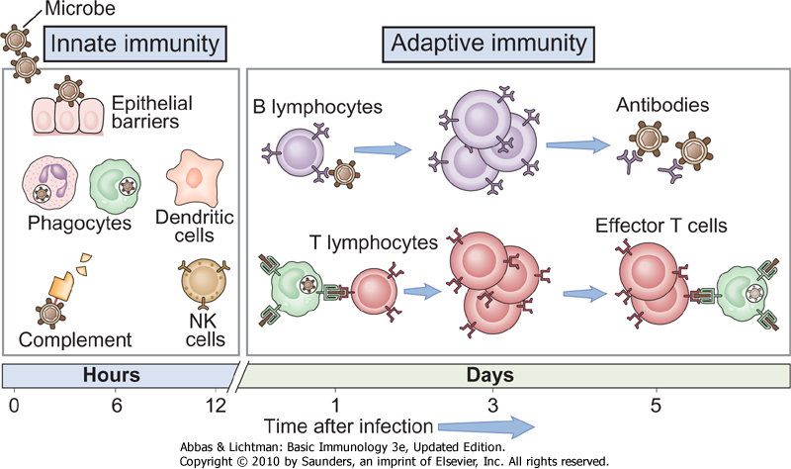
Innate and adaptive immunity
Innate immunity: always present (ready to attack); many pathogenic
microbes have evolved to resist innate immunity
Adaptive immunity: stimulated by exposure to microbe; more potent

Slide 3
Cell-Medicated & Humoral Immunity
Cell-Mediated Immunity: T-Cells
Thymus: where T-cells mature
Regulation of antibody response
Release cytokines: lymphokines, interluekins
Humoral antibody mediated immunity: B-cells
Ex: Monocytes, PMN, Dendritic Cells, Natural Killer Cells, Eosinophil
Antibodies
Immunoglobulins that react specifically with antigen
Gamma globulins (IgG, IgA, IgM, IgE)

Slide 4
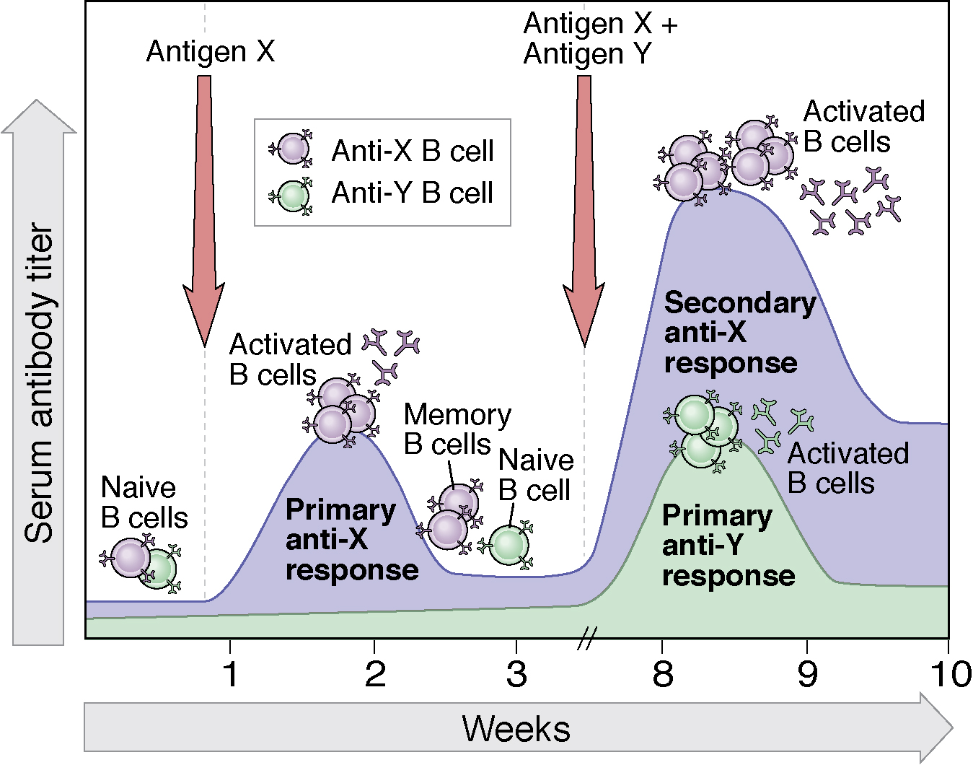
Primary and secondary immune responses illustrate
specificity and memory in adaptive immunity

Slide 5
Ques.
Cell mediated immunity is associated with ______ while humoral immunity is _______.
a. B cells, plasma cells
b. B cells, T cells
c. Plasma cells, T cells
d. T cells, B cells

Slide 6
Immunodeficiency
Humoral (antibody) deficiency associated with:
Recurrent infections with encapsulated bacteria
Chronic sinupulmonary infections
Cell-mediated deficiency characterized by:
Recurrent infections with
Viruses
Fungi
Opportunistic organisms (PCP)
Diarrhea, wasting, growth retardation
Combined immunodeficiency

Slide 7
Bruton’s X-linked Agammaglobulinemia
No B cells
Child clinically well for first 6 months of life
Recurrent upper/lower respiratory tract infections with encapsulated bacteria (S. pneumo, H.influ)
Bronchiectasis → chronic cough/increased sputum
Sepsis, meningitis, skin infections
Paucity of lymphoid tissue (tonsils, adenoids)
Markedly decreased IgG, IgA, IgM
Treatment: IVIG, antibiotic therapy

Slide 8
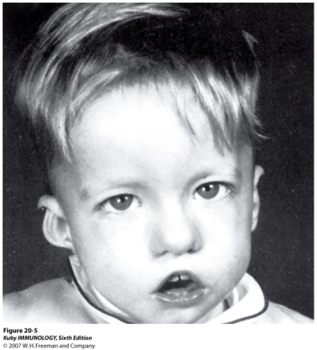
DiGeorge Syndrome
No T cells secondary to thymic hypoplasia
Overwhelming infections with viruses, fungi, bacteria

Slide 9
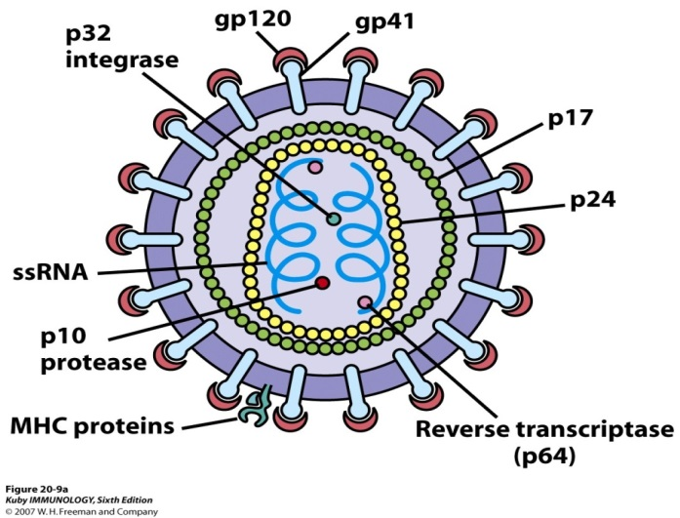
Acquired Immunodeficencies /HIV
When HIV infects humans, the cells it infects most often are CD4 cells
The virus becomes part of the cells, and when they multiply to fight an infection, they also make more copies of HIV
Infected with HIV for a long time = # CD4 cells they have goes down
Sign that the immune system is being weakened
Lower CD4 count = more likely the person will get sick

Slide 10
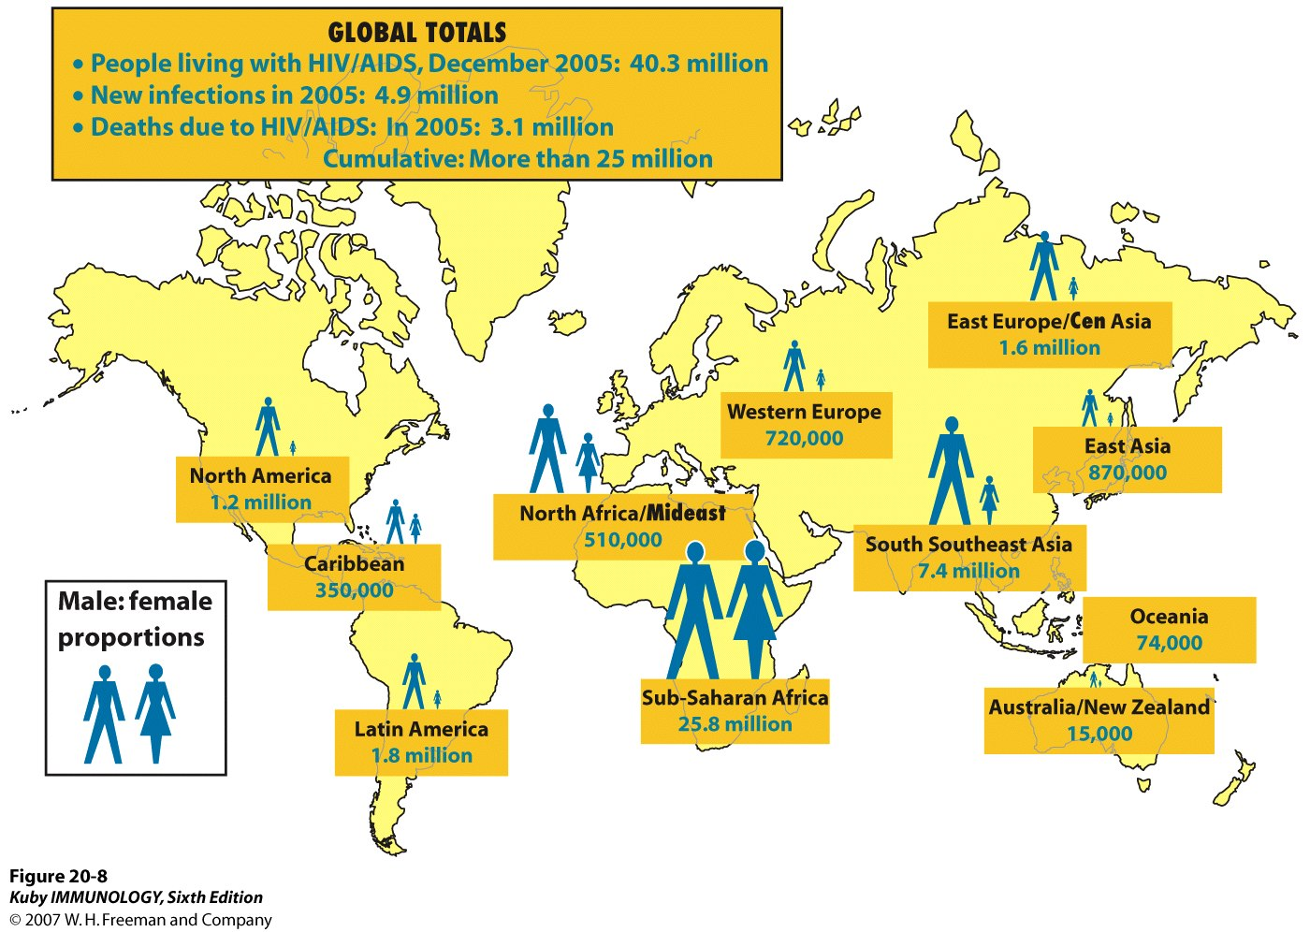

Slide 11
HIV/AIDS
T-Count
CD4 cell values change throughout the day
Reported as the # of cells in a cubic millimeter of blood (mm3)
Normal CD4 counts = 500-1600 (↓ 200 = AIDS)
Normal CD8 counts = 375-1100
T-cell % used by health care professionals to determine overall health of patients
Normal T counts = 20-40%
↓14% = severe immune damage = pt has AIDS
Ratio CD4:CD8 cells
Healthy people = ratio is 0.9-1.9.
1CD4 cells for 2CD8 cells
HIV = ratio varies from normal

Slide 12
Ques.
HIV attaches to which of the following cells?
a. B-Lymphocytes
b. Suppressor T-Lymphocytes
c. Helper T-Lymphocytes
d. Neutrophils
e. Platelets

Slide 13
Clinical Course of HIV-1
Seroconversion = when antibody can be detected in blood for first time
6wks-6mo after exposure
Acute seroconversion syndrome
More than 500 CD4+ T lymphocytes
Detectable HIV antibody may be found as a serum marker of disease
Incubation period
Range from time infection – AIDS symptoms
Could be 15+yrs

Slide 14
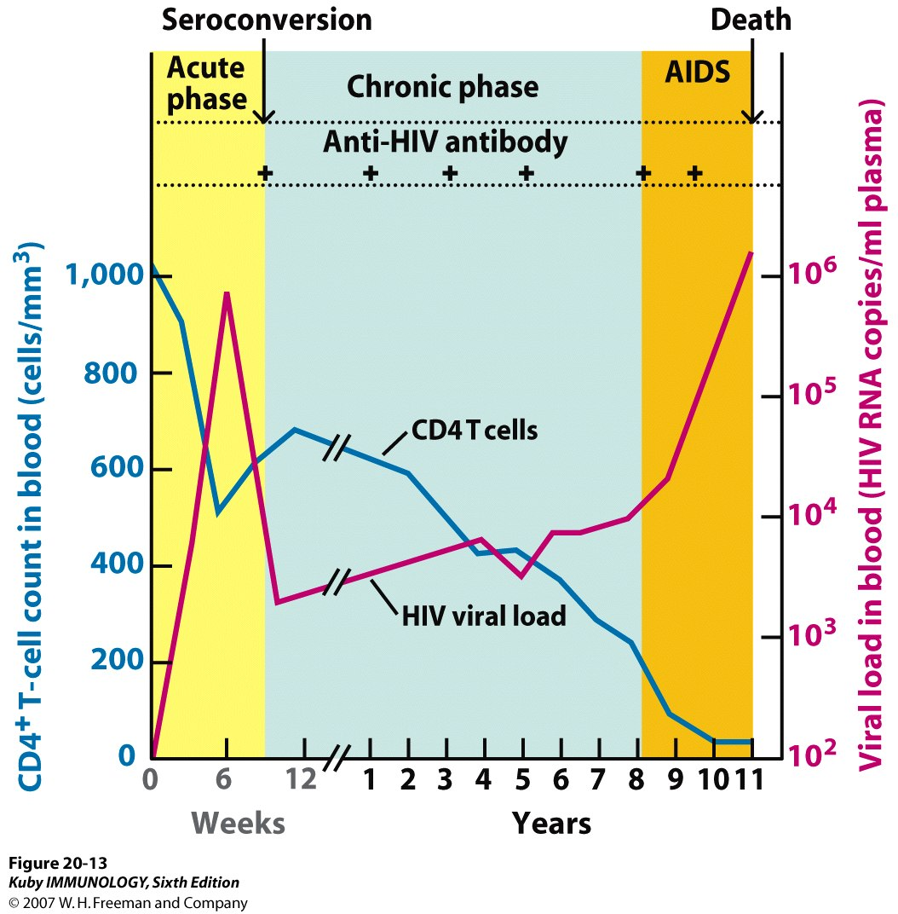

Slide 15
Clinical Course of HIV-1
Early symptomatic HIV+
CD4 200-500 cells
Continued ↑ in viremia
Systemic symptoms: night sweats, weight loss, diarrhea, fever, malaise, general weakness, opportunistic infections, oral lesions more common
Late-stage disease: AIDS
CD4 below 200
Pneumonia, AIDS-dementia complex, Tuberculosis, Neoplasms, HIV-wasting syndrome (Constitutional disease)
Death 1-3yrs (if untreated)

Slide 16
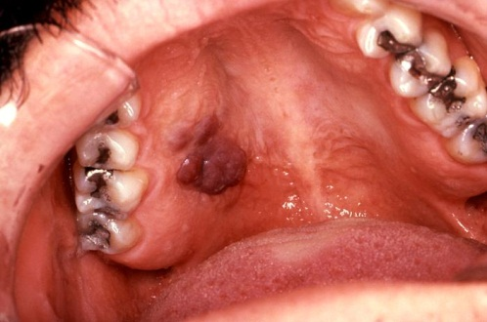
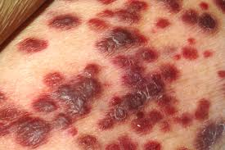
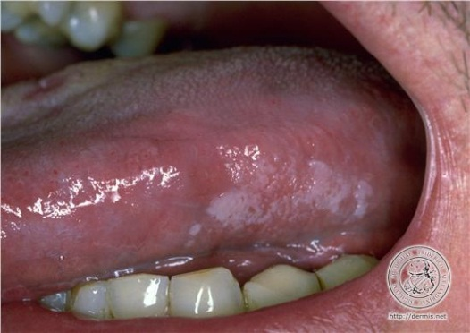
HIV/AIDS Manifestations
Extraoral
Lymphadenopathy
Skin lesions: Kaposi’s sarcoma, zoster, HPV
Intraoral
Candida
Oral warts
Angular cheilitis
Recurrent herpes
Kaposi sarcoma
Opportunistic infections
Tooth erosion from frequent vomiting/nausea
Xerostomia from meds
Hairy leukoplakia
Increased caries
Periodontitis

Slide 17
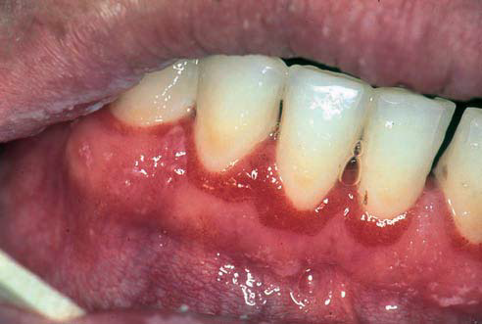
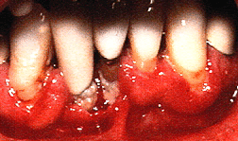
HIV/AIDS Manifestations
Periodontitis : Progress more rapidly, more severe symptoms
Linear gingival erythema
Band of erythema at free gingival margin, 2-3mm apically
Not always related to biofilm presence
Necrotizing Periodontitis
Attachment loss of 6mm in 6mo common

Slide 18
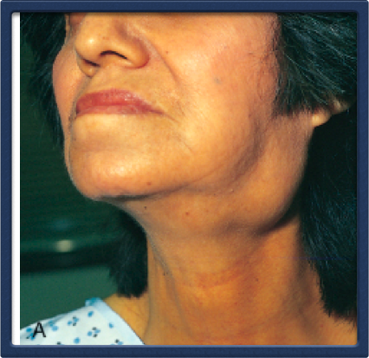
Sjögren's syndrome
Sjogren’s syndrome chronic systemic autoimmune disease characterized by lymphocytic infiltration and destruction of the salivary and lacrimal glands resulting in dry mouth(xerostomia) and dryness and atrophy of conjunctiva and cornea (keratoconjunctivits sicca).

Slide 19
Primary Sjögren’s syndrome - characterized by Sicca complex and extra-glandular symptoms without any additional connective tissue disorder.
Secondary Sjögren’s syndrome occurs in association with another autoimmune disorder such as SLE, RA, or scleroderma

Slide 20
Pathogenesis 1. Genetic factors predispose to Sjogren’s. 2. Environmental factors such as a viral infection may lead to formation of autoantibodies. 3. Antibodies precede disease (however, presence of antibody does not necessarily mean disease).
Innate
Immune system
(Toll receptor)
Environmental
Factor
(virus-such as EBV)
(apoptotic fragment)
Auto-
antibodies
Immune
complex
Type I IFN
Genetic
Factors
(including sex)
(HLA-DR)
Genetic
Factors
(including sex)
(HLA-DR)
Genetic
Factors
(including sex)
(HLA-DR)
Genetic
Factors
(including sex)
(HLA-DR)
Genetic
Factors
(including sex)
(HLA-DR)
Acquired
Immune system
(HLA-DR)
T/B-cells
Disease
Manifestations

Slide 21
Clinical Manifestations
dry, gritty eyes which may lead to corneal ulceration (keratoconjunctivitis sicca)
dry mouth (xerostomia), with dysphagia for dry foods, and predisposition to oral candidiasis and accelerated dental caries
salivary gland enlargement Less commonly other exocrine glands may be affected leading to sinusitis

Slide 22
Extraglandular features may include:
non-erosive arthritis/arthralgia (up to 60–70% of cases)
Raynaud’s phenomenon
cutaneous vasculitis
interstitial lung disease
interstitial nephritis
distal renal tubular acidosis
peripheral neuropathy/mononeuritis multiplex.

Slide 23
Diagnosis
Schirmer’s test: a small strip of filter paper is hooked over the lower eyelid; wetting of < 5mm in 5 min is considered abnormal.
Slit lamp examination with Rose Bengal staining confirms dryness and corneal damage.
Assessment of saliva flow rates and salivary gland scintigraphy.
ESR is raised.
Rheumatoid factor is typically detected (90% of cases) and ANA frequently present (70%).
Anti-Ro (anti-SSA) and anti-La (anti-SSB) antibodies are found in approximately 50% of cases.
Biopsy of minor salivary glands shows a focal T cell infiltrate.

Slide 24
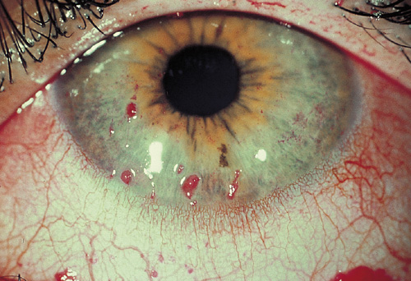
Keratoconjunctivitis sicca (rose bengal test) in SS
Keratoconjunctivitis sicca (rose bengal test) in SS

Slide 25
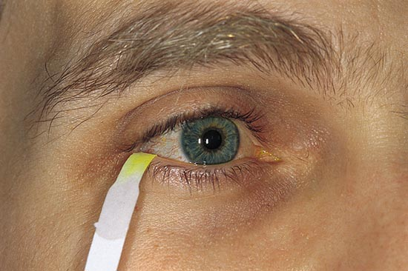
Schirmer’s test
Schirmer’s test

Slide 26
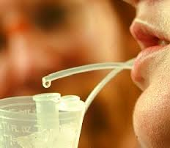
Sialometry
The patient is asked to spit
into a test tube every minute
for 15 minutes.
A resultant collection of less
than 1.5 mL is considered
a positive result.

Slide 27
15

Slide 28
Treatment of DRY MOUTH
Artificial Saliva.
pilocarpine
Fluoride to prevent caries
Treat oral candida

Slide 29
Systemic Manifestations
Steroids work but have side effects.
Hydroxychloroquine
Methotrexate, Azathioprine
Mycophenolic acid mofetil
Anti-CD20 (rituximab) glandular swelling, extraglandular renal and lung.

Slide 30
SYSTEMIC LUPUS ERYTHEMATOSUS
Inflammatory autoimmune disorder affecting multiple organ systems characterized by the production of autoantibodies directed against cell nuclei

Slide 31
CLINICAL FEATURES: Mucocutaneous
Malar Rash (butterfly erythema)
Discoid rash
Photosensitive rash
Subacute cutaneous LE
Livedo reticularis
Alopecia
Raynaud’s
Vasculitic ulceration
Oral ulceration
Nasal septal perforation
Nailfold capillary changes

Slide 32
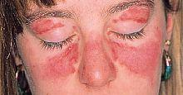
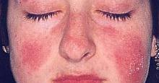
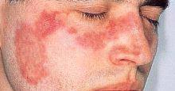
MALAR RASH
Fixed erythema, flat or raised, over the malar eminences
Tending to spare the nasolabial folds

Slide 33
ORAL ULCERS
Oral or nasopharyngeal ulceration
Usually painless, observed by a physician

Slide 34
Laboratory Findings
Complete blood count
Anemia
Leukopenia
Lymphopenia
Thrombocytopenia
Urine Analysis
Hematuria
Proteinuria
Granular casts

Slide 35
Immunological findings
ANA - 95-100%-sensitive but not specific for SLE
Anti -ds DNA-specific(60%)-specific for SLE, but positive to other non lupus conditions
4 RNA associated antibodies
Anti-Sm (Smith)
Anti Ro/SSA-antibody
Anti La/SSB-antibody
Anti-RNP
Antiphospholipid antibody
Lupus anticoagulant-antibodies tocoagulation factors. risk factor for venous and arterial thrombosis and miscarriage. Prolonged aPTT
Anti-cardiolipin
Depressed serum complement
Anti histones antibodies

Slide 36
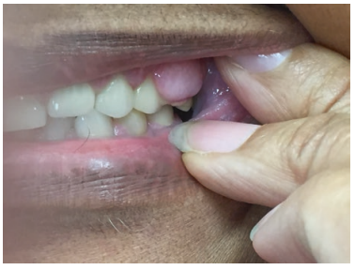
Ques.1
A patient with lupus membranous nephropathy who has been on mycophenylate mofetil (MMF), low dose prednisone and cyclosporine for 5 years, presents with the oral lesions below. What complication has occurred? How would you treat her?

